Slide 1
Data Structures
ICT-1211
Information and Communication Technology
Lecture-05
Date:

Slide 2
String Processing

Slide 3
String Operation
Substring:
Accessing a substring from a given string requires three pieces of information:
The name of the string or the string itself.
The position of the first character of the substring in the given string
The length of the substring of the position of the last character of the substring.
We call this operation SUBSTRING. Specially we can write
SUBSTRING (string, initial, length)

Slide 4
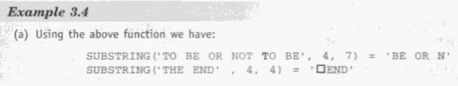
String Operation
Substring:
SUBSTRING (string, initial, length)

Slide 5
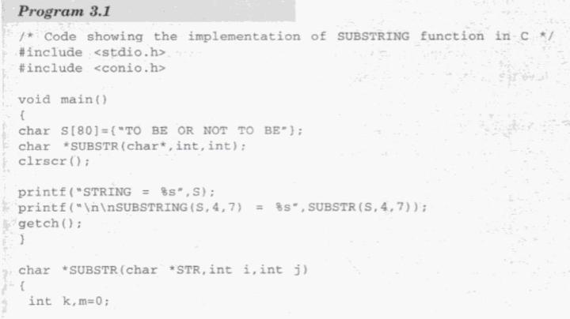
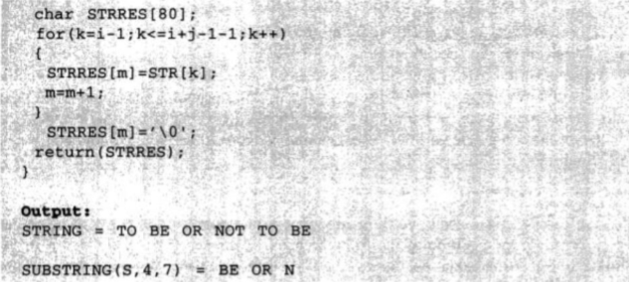
String Operation

Slide 6
String Operation
Indexing:
Indexing, also called pattern matching, refers to finding the position where a string pattern P first appears in a given string text T.
We call this operation INDEX and write
INDEX (text, pattern)
If the pattern P does not appear in the text T, then INDEX is assigned the value 0. The arguments “text” and “pattern” can be either string or string variables.

Slide 7
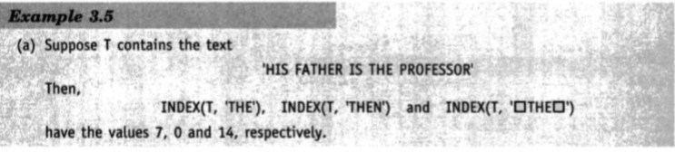
String Operation
Indexing:
INDEX (text, pattern)

Slide 8
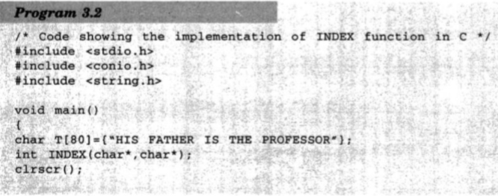
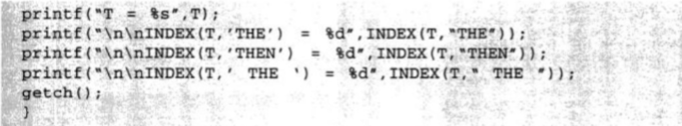
String Operation

Slide 9
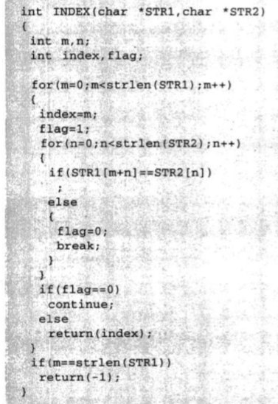
String Operation

Slide 10
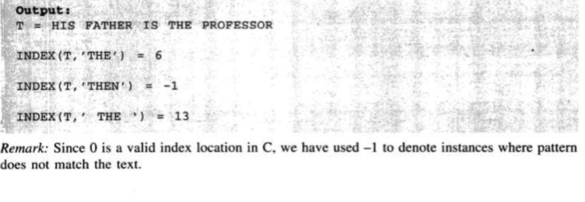
String Operation

Slide 11
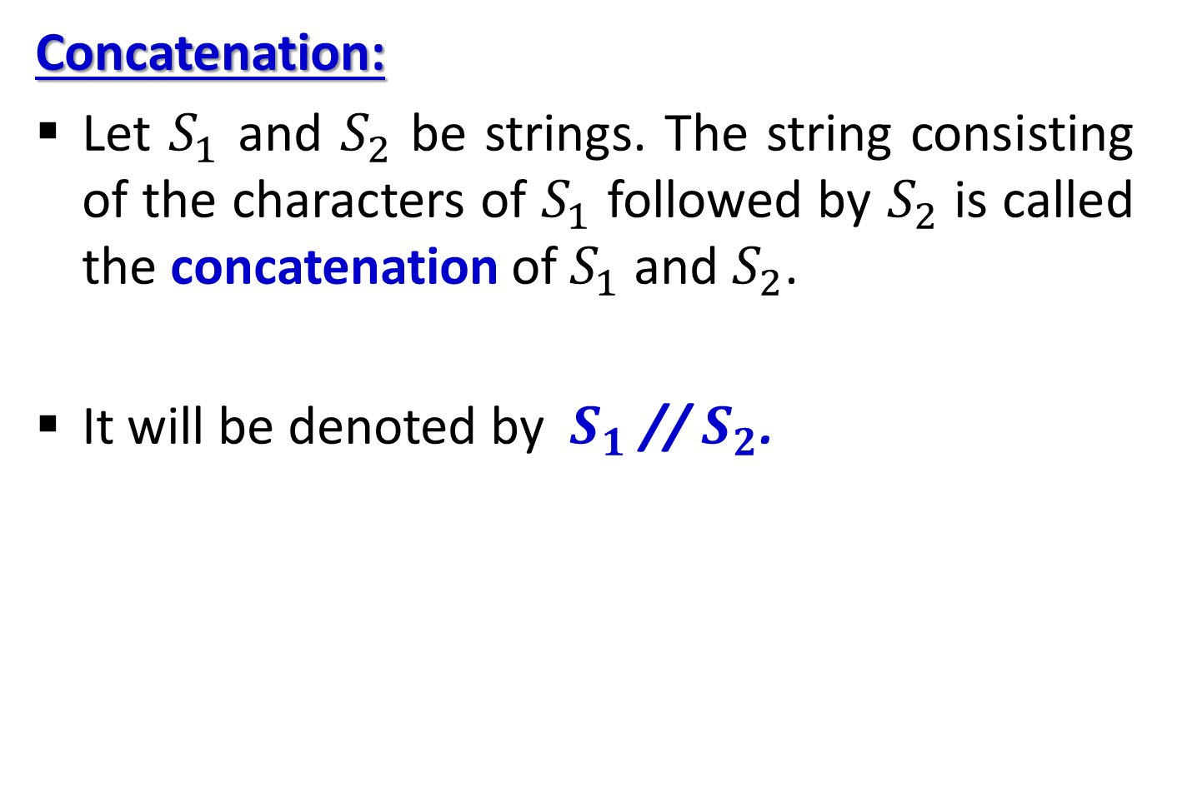
String Operation
Concatenation:
Let $S_{1}$ and $S_{2}$ be strings. The string consisting of the characters of $S_{1}$ followed by $S_{2}$ is called the concatenation of $S_{1}$ and $S_{2}$.
It will be denoted by $S_{1}$ // $S_{2}$.

Slide 12
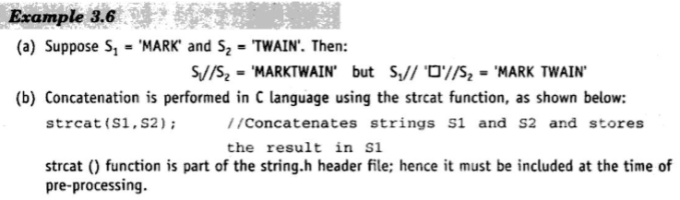
String Operation
Concatenation:

Slide 13
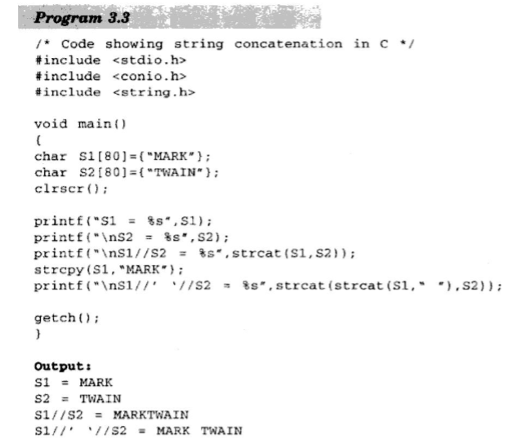
String Operation

Slide 14
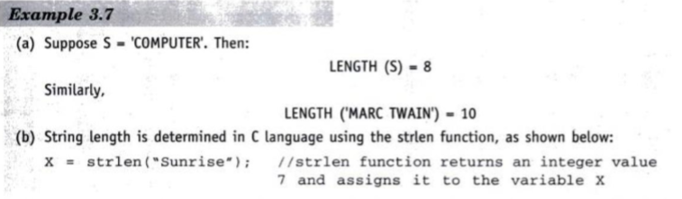
String Operation
Length:
The number of characters in a string is called its length. We will write
LENGTH(string)

Slide 15
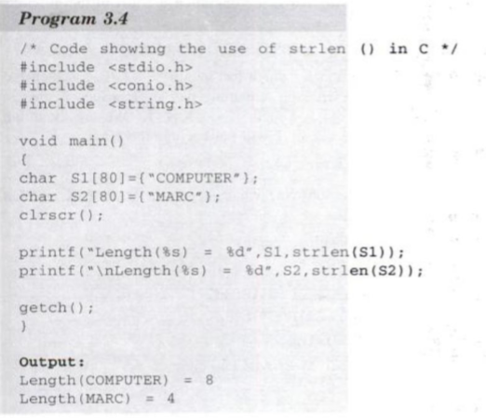
String Operation

Slide 16
Word Processing
The operations usually associated with word processing are the following:
  Insertion: Inserting a string in the middle of the text.
  Deletion: Deleting a string from the text.
  Replacement: Replacing one string in the text by another.

Slide 17
Word Processing
Insertion:
Suppose in a given text T we want to insert a string S so that S begins in position K. We denote this operation by
INSERT(text, position, string)
Example:
INSERT( ‘ABCDEFG’, 3, ‘XYZ’ ) = ‘ABXYZCDEFG’
INSERT( ‘ABCDEFG’, 6, ‘XYZ’ ) = ‘ABCDEXYZFG’

Slide 18

Word Processing
Insertion:
The INSERT function can be implemented by using the string operations as follows:
INSERT(T, K, S)
= SUBSTRING(T, 1, K-1) // S // SUBSTRING(T, K, LENGTH(T) – K + 1)

Slide 19
Word Processing
Deletion:
Suppose in a given text T we want to delete the substring which begins in position K and has length L. We denote this operation by
DELETE(text, position, length)
Example:
DELETE( ‘ABCDEFG’, 4, 2) = ‘ABCFG’
DELETE( ‘ABCDEFG’, 2, 4) = ‘AFG’

Slide 20
Word Processing
Deletion:
We assume that nothing is deleted if position K=0. Thus
DELETE( ‘ABCDEFG’, 0, 2) = ‘ABCDEFG’

Slide 21
Word Processing
Deletion:
The DELETE function can be implemented by using the string operations as follows:
DELETE(T, K, L)
= SUBSTRING(T, 1, K-1) // SUBSTRING(T, K+L, LENGTH(T) – K – L + 1)

Slide 22

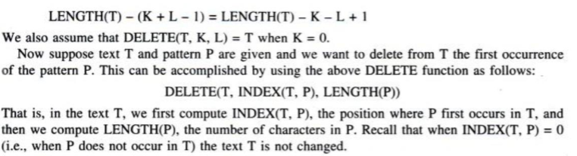
Word Processing
Deletion:
DELETE(T, K, L)
= SUBSTRING(T, 1, K-1) // SUBSTRING(T, K+L, LENGTH(T) – K – L + 1)

Slide 23
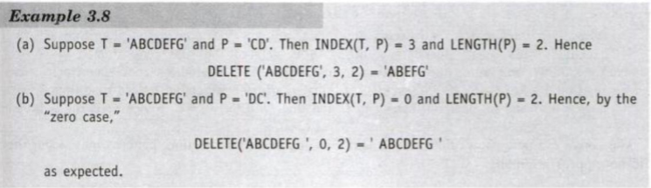
Word Processing
Deletion:

Slide 24
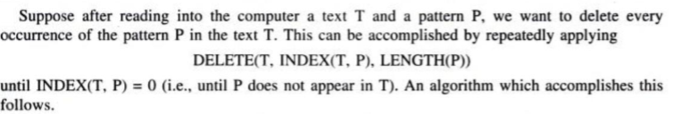
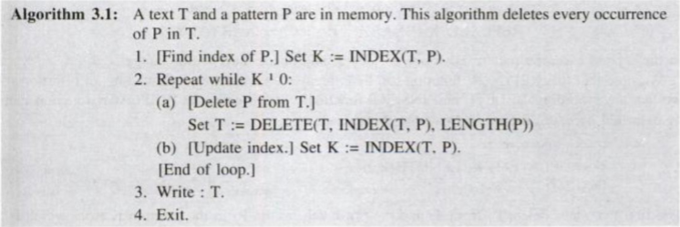
Word Processing
Deletion:

Slide 25
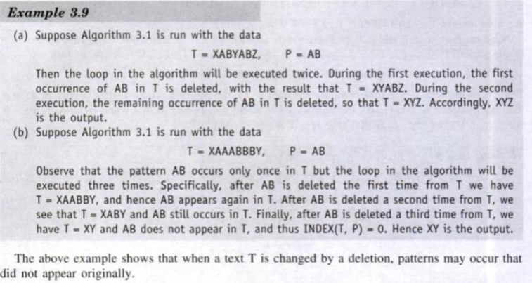
Word Processing
Deletion:

Slide 26
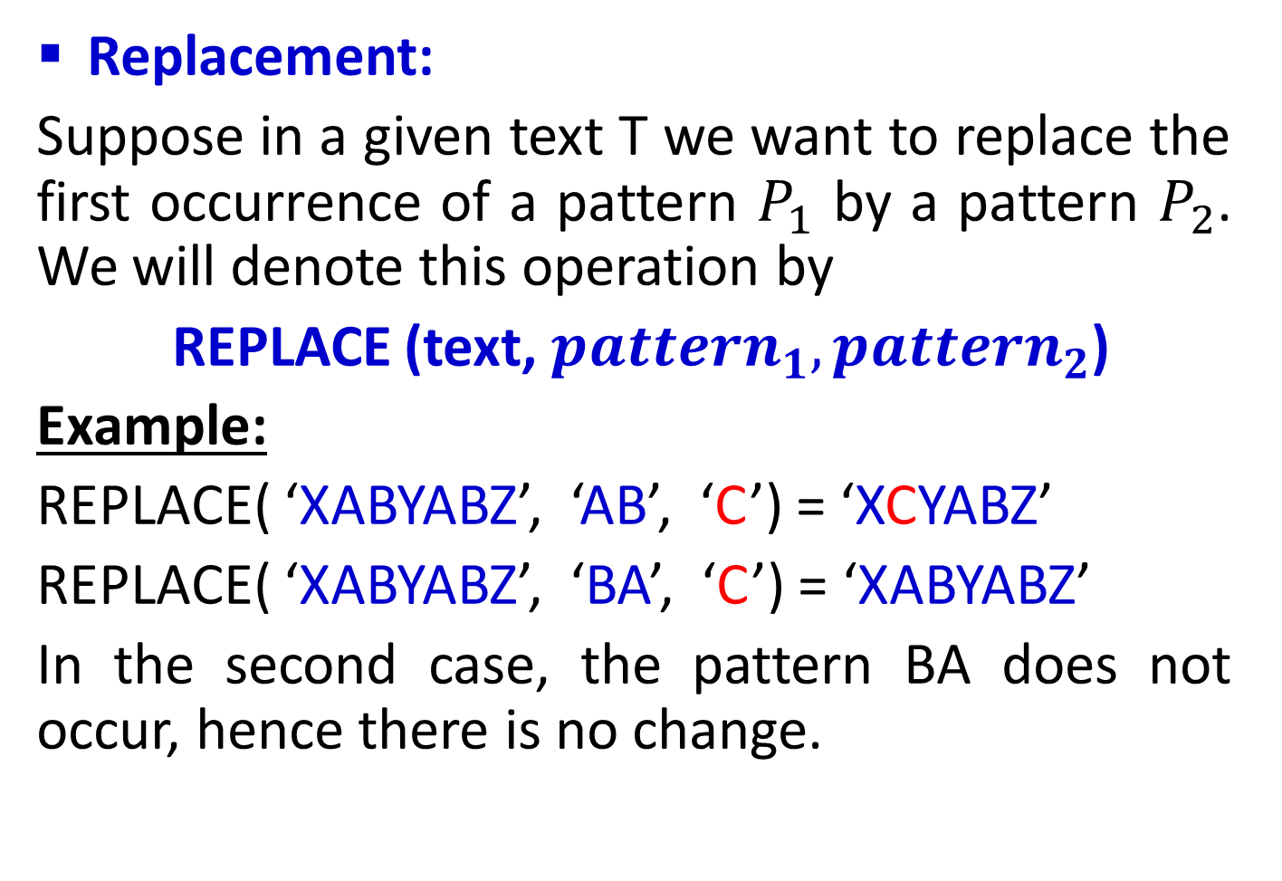
Word Processing
Replacement:
Suppose in a given text T we want to replace the first occurrence of a pattern $P_{1}$ by a pattern $P_{2}$. We will denote this operation by
REPLACE (text, ${pattern}_{1},{pattern}_{2}$)
Example:
REPLACE( ‘XABYABZ’, ‘AB’, ‘C’) = ‘XCYABZ’
REPLACE( ‘XABYABZ’, ‘BA’, ‘C’) = ‘XABYABZ’
In the second case, the pattern BA does not occur, hence there is no change.

Slide 27
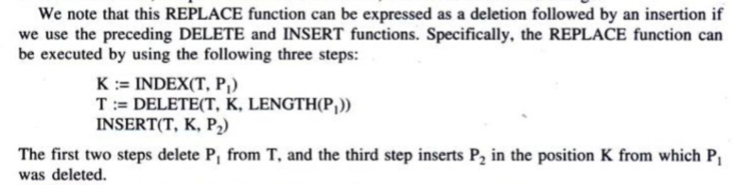
Word Processing
Replacement:

Slide 28
Thank you……

